Slide 1
Better safe than sorry

Slide 2
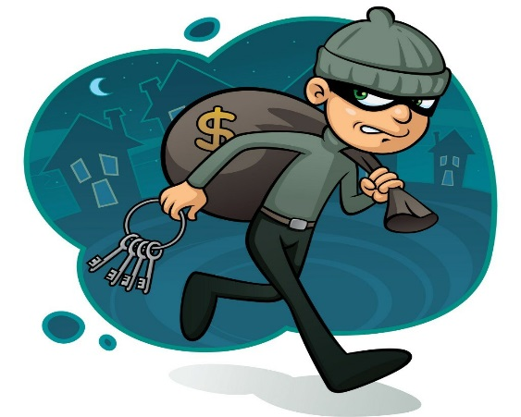
explain the words in Russian
Give to some
Identification
A small hole to look through
Machine that signals danger
Connect or fix sth position
Turned on

Slide 3
match these sentences and words
Give to some peephole
Identification switched on
A small hole to look through ID
Machine that signals danger alarm system
Connect of fix sth position install
Turned on hand over

Slide 4
let’s check
Peephole – дверной глазок
Switched on – включен
ID – идентификация
Alarm system – сигнализация
Install – установить
Hand over – передать

Slide 6
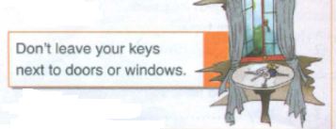

Slide 9
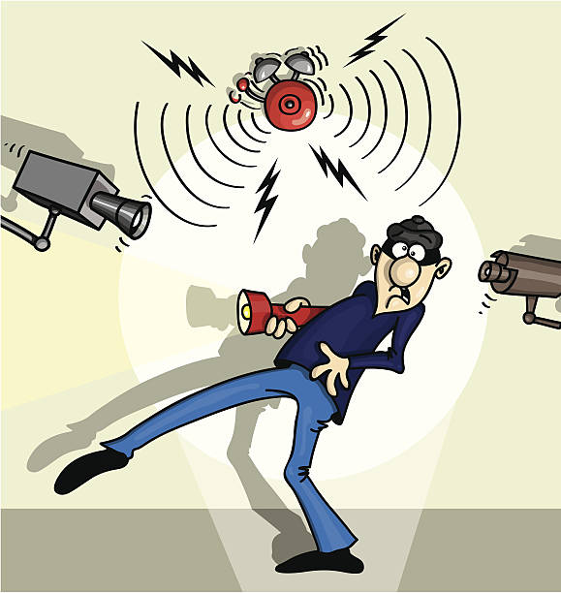
1. What is Jo’s dad doing? 2. What problems do the burglars cause? 3. What advice does Jo give Dan?

Slide 10
careful - ?
carefully
Safe -
Sure –
Bad -
safely
surely
badly

Slide 12
-new words - safety rules -word formation
What I learned today?

