Slide 2
[æ]
э-э-э
bag
black
cat
map

Slide 3
[ɒ]
doll
clock
sock
cock

Slide 4
[u]
yyy
book
hook
wood
cook

Slide 5
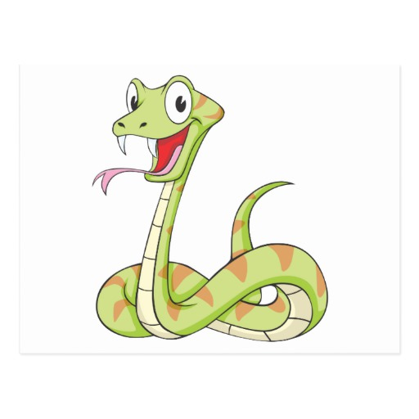
[ ʃ ]
fish
dish
ship
shop

Slide 6
[d]
bed
desk
kid
red

Slide 7
[b]
book
black
bag
big

Slide 8
cock

Slide 9
wood

Slide 10
sock

Slide 11
jug

Slide 12
dish

Slide 13
hook

Slide 14
lamp

Slide 15
mug

Slide 16
1)a red cup 2)a little ant 3)a black mug 4)a big book
a)
c)
b)
d)

Slide 17
Read names
Andy
Nick
Polly
Betty
Jimmy
Sally

Slide 18
Подставь недостающие буквы, чтобы получить имя.
An
Ni
Pol
Bet
Jim
Sal

Slide 19
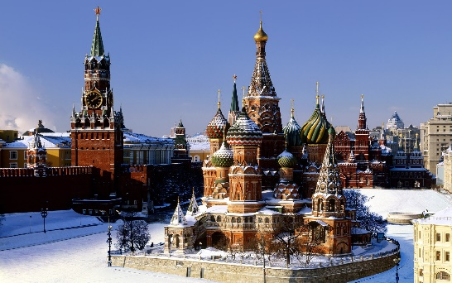
Я из Москвы.
Откуда ты\вы родом, Маша?
I`m from Moscow.
Where are you from, Masha?

Slide 20
I`m fine, thank you.
Hi, Никита. How are you?

Slide 21
I`m Nick.
What is your name?

Slide 22
Попробуем построить диалог.
Hello, my name is Nick. What is your name?
Hello, I`m Ann. Nice to meet you, Nick.
Nice to meet you, Ann.
Where are you from, Nick?
I`m from Moscow. Where are you from?
I`m from London.

Slide 23
Homework
1.Step 20 упр.1-4 стр. 33-34
2.Подготовка к КР.

