Slide 1
Spotlight 11
Урок-обобщение Brainstorm к УМК «Spotlight 11»
выполнила: учитель английского языка
Лицея №36 ОАО «РЖД» г. Иркутска Кришталь Светлана Сергеевна

Slide 2
BRAINSTORM
Idioms
100
200
300
400
500
VOCABULARY
100
200
300
400
500
Grammar
100
200
300
400
500
Pig in a poke
100
200
300
400
500
listening
100
200
300
400
500

Slide 3
IDIOMS
100
- What’s the meaning of the idiom?
I prefer to talk to people face to face rather than to talk on the phone.
In person
Facing them
Looking at them
Seeing them
In person

Slide 4
IDIOMS
200
What’s the meaning of the idiom?
Yes, we went away on holiday last week but it rained day in, day out
Every single day
Every other day
Every second day
Every two days
Every single day

Slide 5
IDIOMS
300
What’s the meaning of the idiom?
It was late at night, the wind was howling and when she heard the knock on the door, she almost jumped out of her skin.
Was pleased
Was terrified
Was asleep
Was delighted
Was terrified

Slide 6
IDIOMS
400
What’s the meaning of the idiom?
I just want to stay at home, watch TV and take it easy.
Sleep
Sit down
Eat
Relax
Relax

Slide 7
IDIOMS
500
What’s the meaning of the idiom?
Since she won the lottery last week she’s been feeling on top of the world.
Very proud
Very happy
Very excited
Very healthy
Very proud

Slide 8
VOCABULARY
100
Complete the gaps:
Without my husband’s _____, I wouldn’t have made it in the fashion bussiness.
Support

Slide 9
VOCABULARY
200
Complete the gaps:
They interrupted normal programming with a news ____ about the tragedy.
Flash

Slide 10
VOCABULARY
300
Complete the gaps:
Stop talking in _____I can’t understand you.
Riddles

Slide 11
VOCABULARY
400
Complete the gaps:
I expected you to arrive hours ago. – I’m sorry, I had a ____flight, so I missed my _____.
Flight, connection

Slide 12
VOCABULARY
500
Say the phrase in different words:
Even though something seems completely impossible.
Against all odds

Slide 13
GRAMMAR
100
Join the sentences using relative pronoun:
My parents moved to the city to find work. They were born in a small village.
My parents moved to the city from the village where they were born.

Slide 14
GRAMMAR
200
Put the verbs in the Past tenses:
(your brother/be) at home when you (arrive)?-No, he (already/ go out).
Was your brother/ arrived
Had already gone

Slide 15
GRAMMAR
300
Write the headline in a full sentence using the Passive Voice:
Prime minister to open a new museum next week
A new museum will be opened next week

Slide 16
GRAMMAR
400
Make a sentence using the causative form:
A nurse bandaged Helen’s wrist to give it support.
Helen had her wrist bandaged by a nurse

Slide 17
GRAMMAR
500
Use the words to make a 3d conditional sentence:
I/ run out/ of petrol/ if/ I/ not find/ a petrol station
If I hadn’t found a petrol station, I would have run out of petrol.

Slide 18
PIG IN A POKE
100
Change the word into a suitable form:
Edinburgh is a delight to explore on foot: most of its ____ are contained within a compact central area. (attract)
attractions

Slide 19
PIG IN A POKE
200
Find a mistake:
Very little scientists come up with completely new answers to the world’s problem.
Very few

Slide 20
PIG IN A POKE
300
Rewrite the sentence into Direct Speech:
He said that his bus hadn’t come in time the day before.
He said: “My bus didn’t come in time yesterday.”

Slide 21
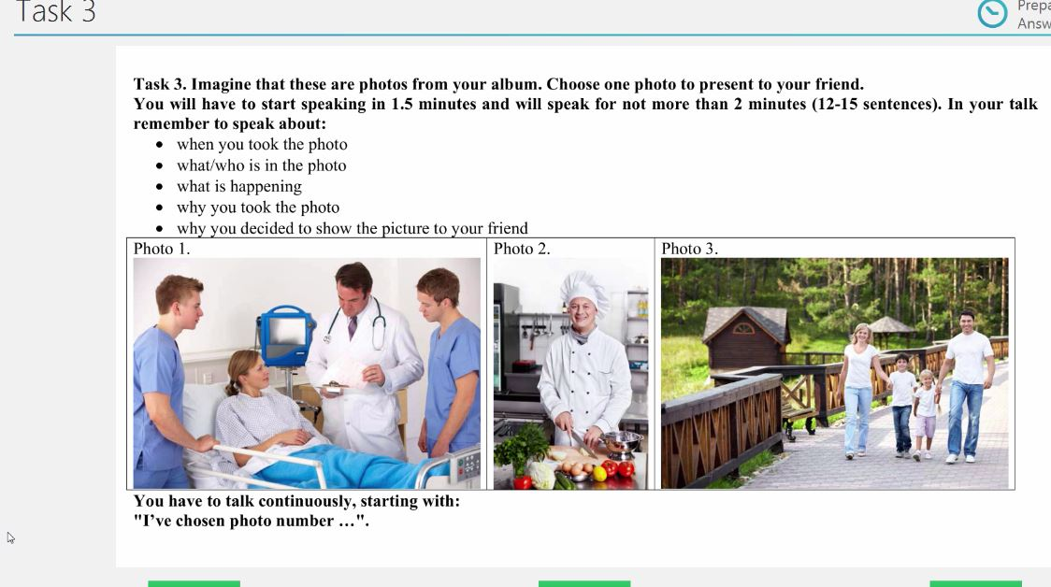
PIG IN A POKE
400

Slide 22
PIG IN A POKE
500

Slide 23
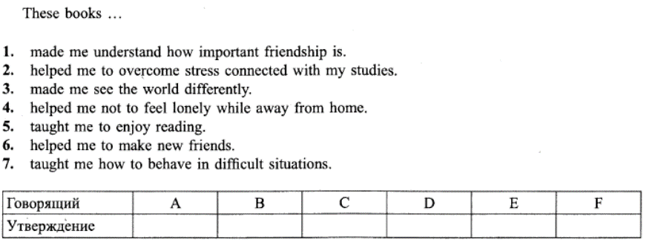
LISTENING
100
Match the speaker with the statement
4-1-7-3-5-2

Slide 24
LISTENING
200
Match the speaker with the statement:
2-5-1-3-4-7

Slide 25
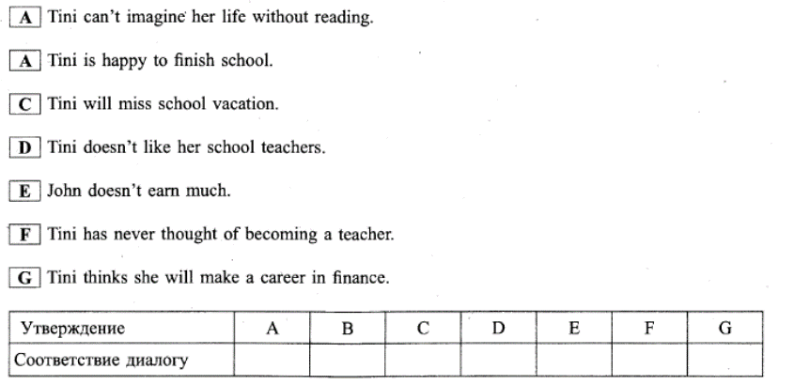
LISTENING
300
Find out if the following statements are TRUE, FALSE, NOT STATED
2-2-1-3-1-2-1

Slide 26
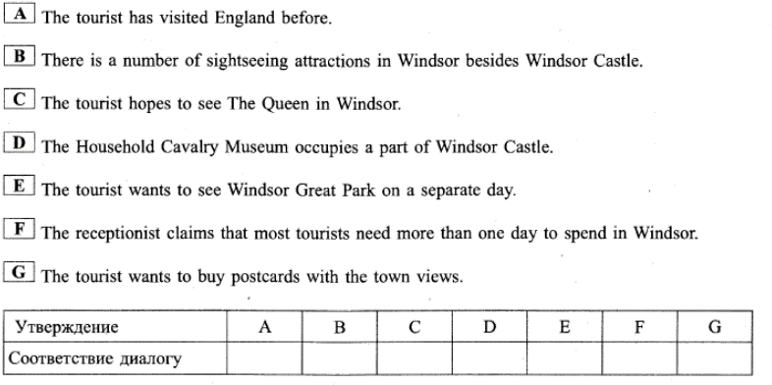
LISTENING
400
Find out if the following statements are TRUE, FALSE, NOT STATED
2-1-3-2-2-1-3

Slide 27
LISTENING
500
Looking at your paper listen to the tape and choose the correct variant:
3-2-3-1-1-2-1

