Slide 1
Quiz
the UK
Venikova Nadezhda Nikolaevna,
The teacher of the English language
Gymnasium №7, Bataysk
5th -6th grades

Slide 2
What are the largest islands of the British Isles?
Great Britain
and Ireland

Slide 3
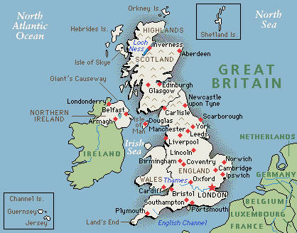
Give the official name of the UK?
The United
Kingdom
of Great
Britain and
Northern
Ireland

Slide 4
Give the other names of the country?
The United Kingdom
The United
Kingdom
of Great
Britain and
Northern
Ireland
The UK
Great Britain
Britain
GB

Slide 5
Guess the parts
of Great Britain
England - grey .
Wales- red
Scotland -green

Slide 6
Name the parts
of the UK
England .
Wales
Scotland
Northern
Ireland

Slide 7
What are the colours
of the British flag?
Blue, red, white.

Slide 8
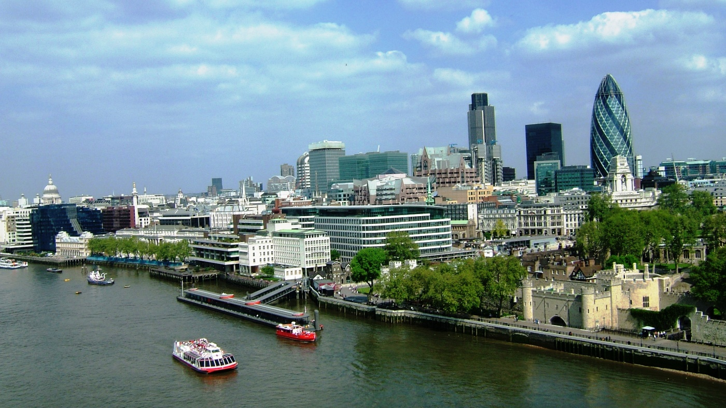
What’s the capital of the UK?
London

Slide 9
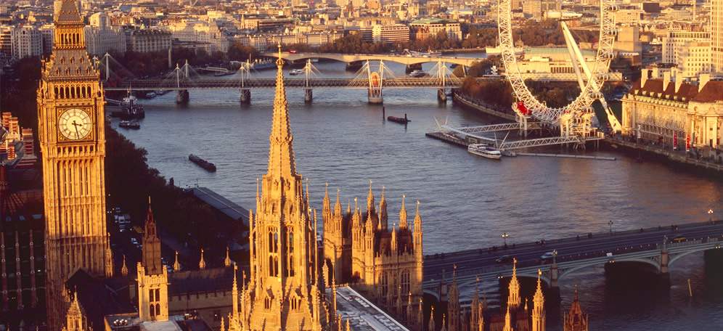
What’s the capital of England?
London

Slide 10
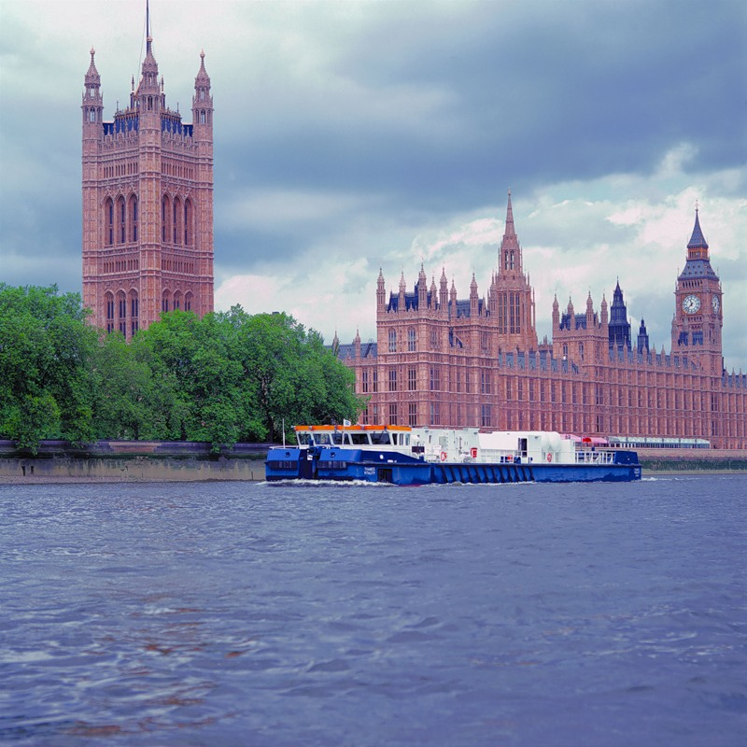
Which river does London stand on ?
the Thames

Slide 11
What are the colours of the national flag of England?
Red and white

Slide 12
What is the symbol of England?
Rose

Slide 13
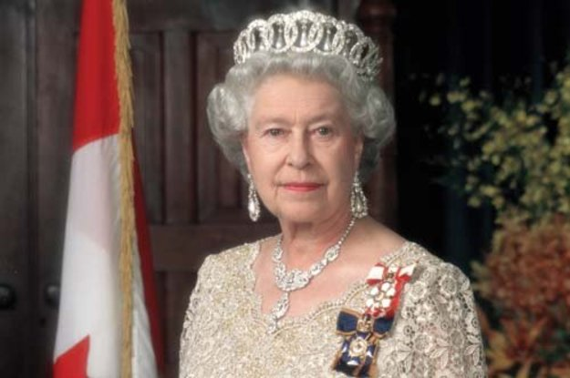
What’s the name of British Queen?
Elizabeth

Slide 14
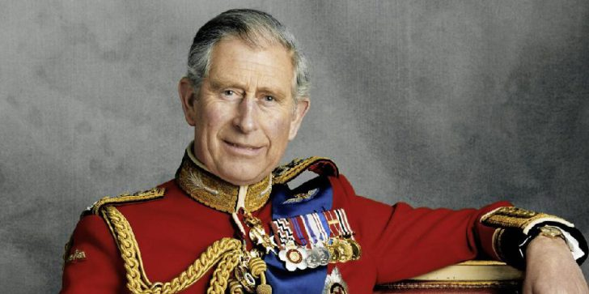
Who is the Prince of Wales?
Prince
Charles

Slide 15
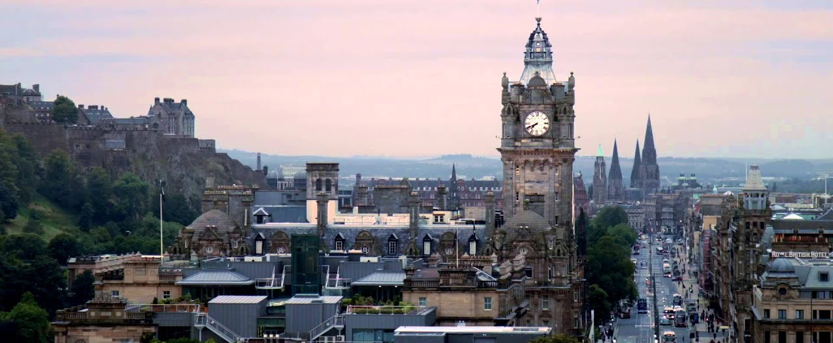
Name the capital of Scotland
Edinburgh.

Slide 16
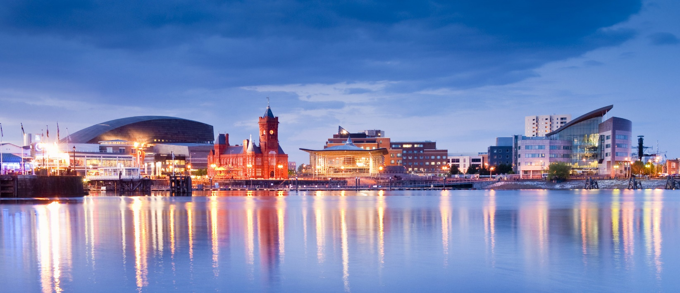
Name the capital of Wales
Cardiff

Slide 17
Name national flags

Slide 18
What is the symbol of UK?
the leek

Slide 19
The Highlands are the oldest mountains of the world.
Where are
they
located?
In Scotland

Slide 20
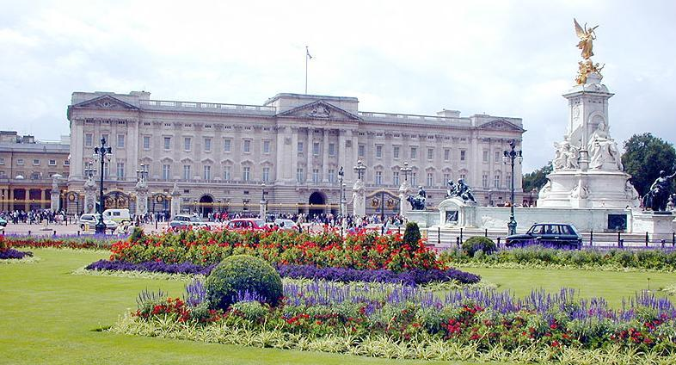
What is the London home
of the Queen of UK?
Buckingham
Palace.

Slide 21
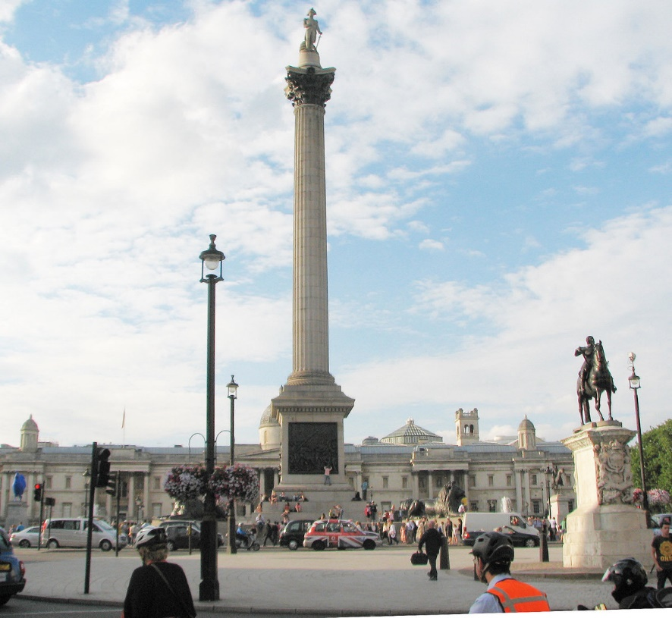
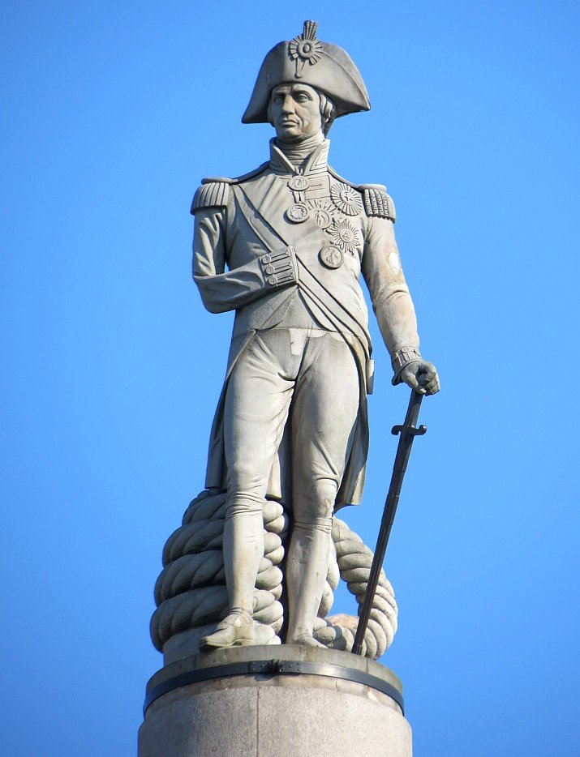
What is in the center of
Trafalgar-Square?
the monument
to Admiral
Nelson

Slide 22
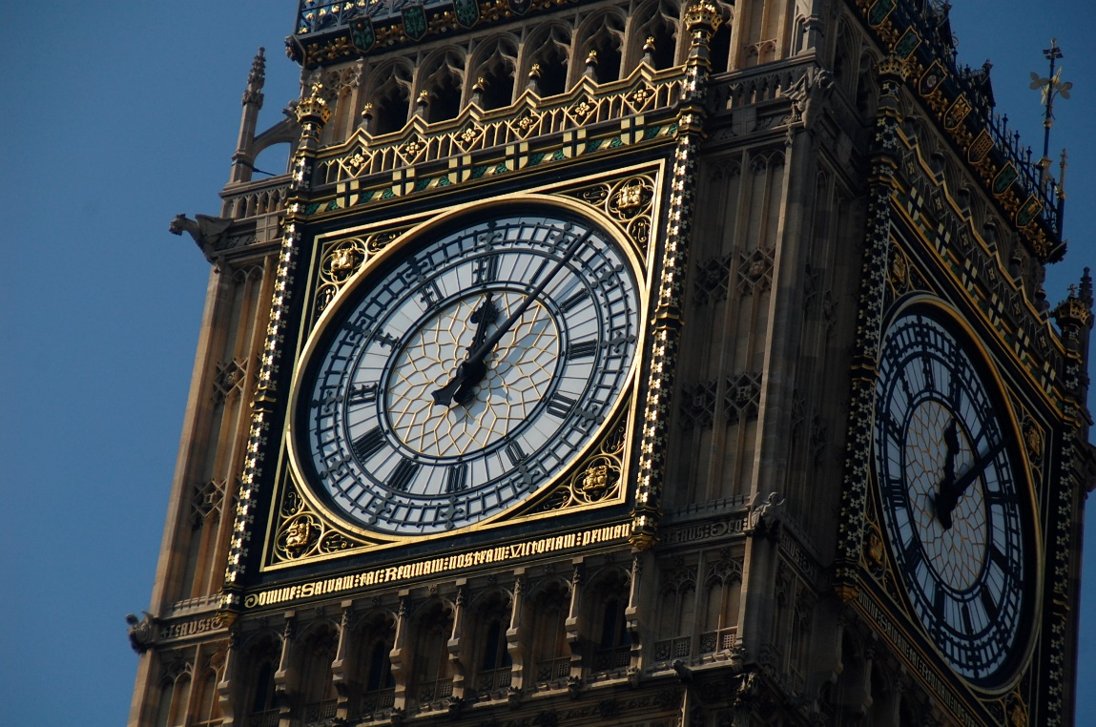
What’s the name of the most famous clock tower in London?
Big Ben.

Slide 23
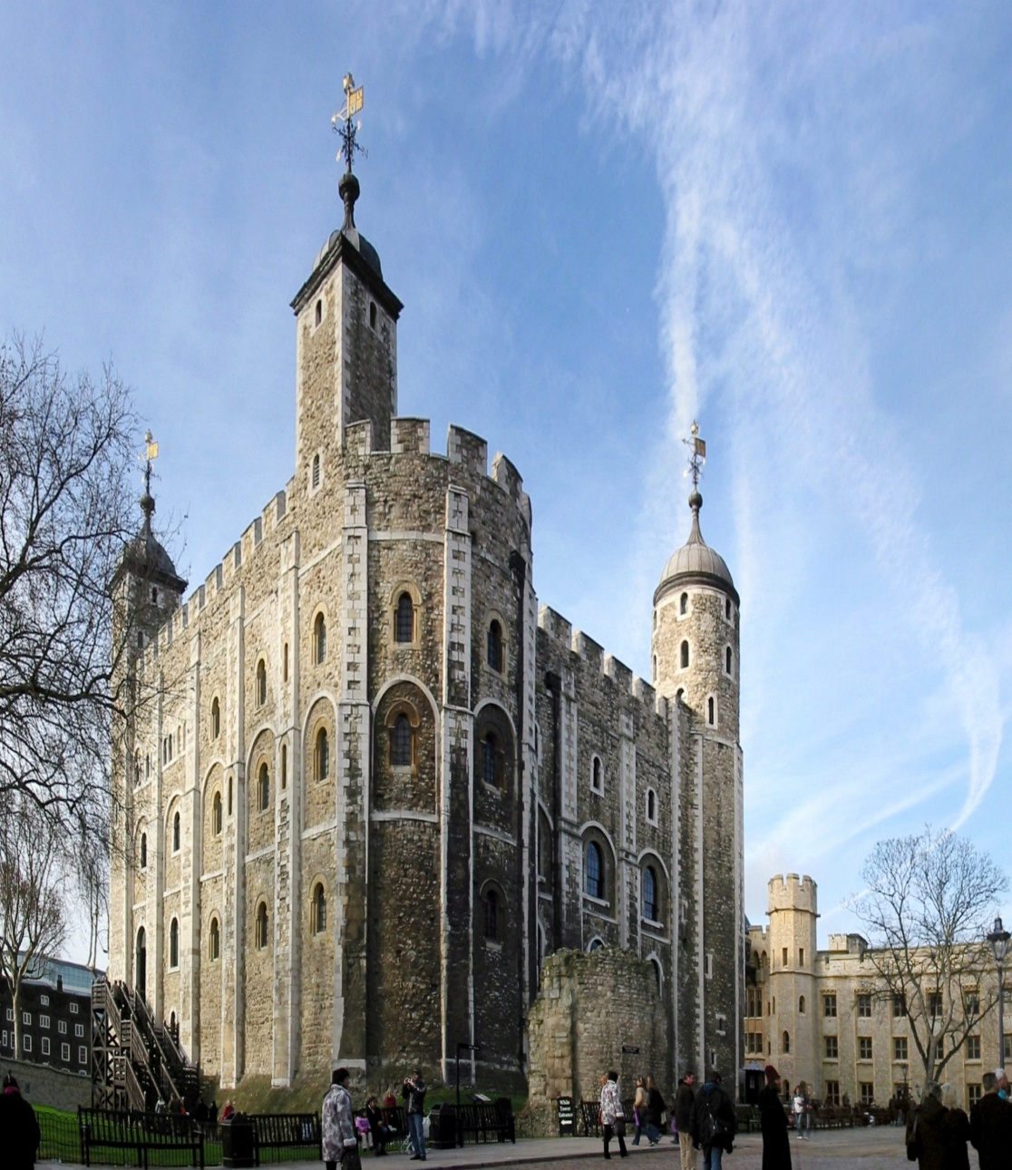
What is the Tower
of London
now?
a museum

Slide 24
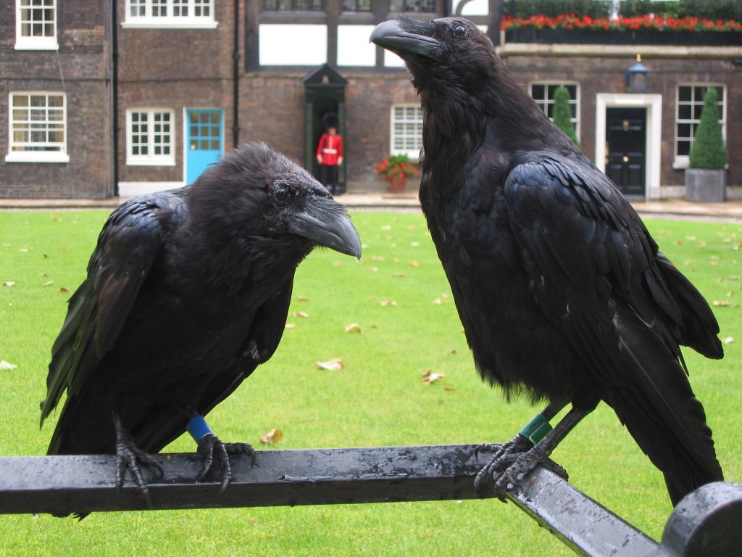
What birds live in the
Tower of London?
ravens

Slide 25
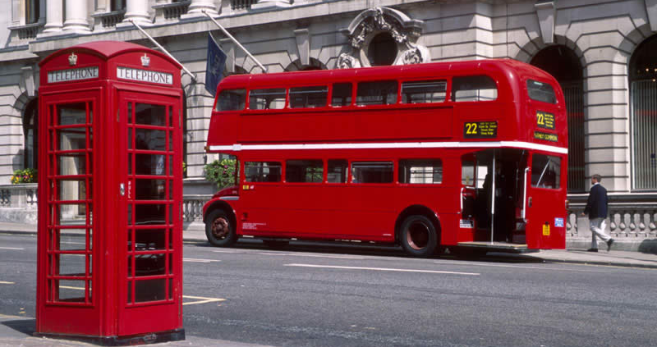
What colour are the buses, postboxes and telephones in the UK?
red

Slide 26
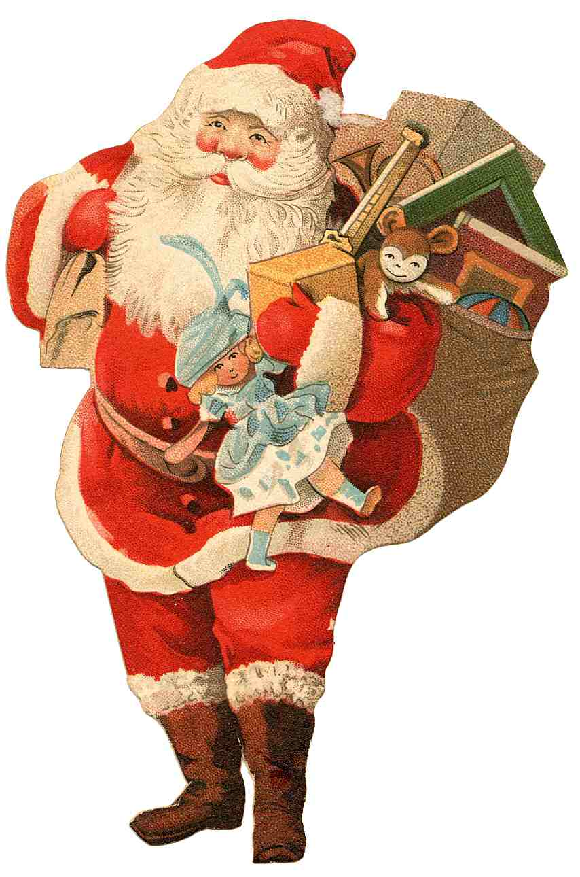
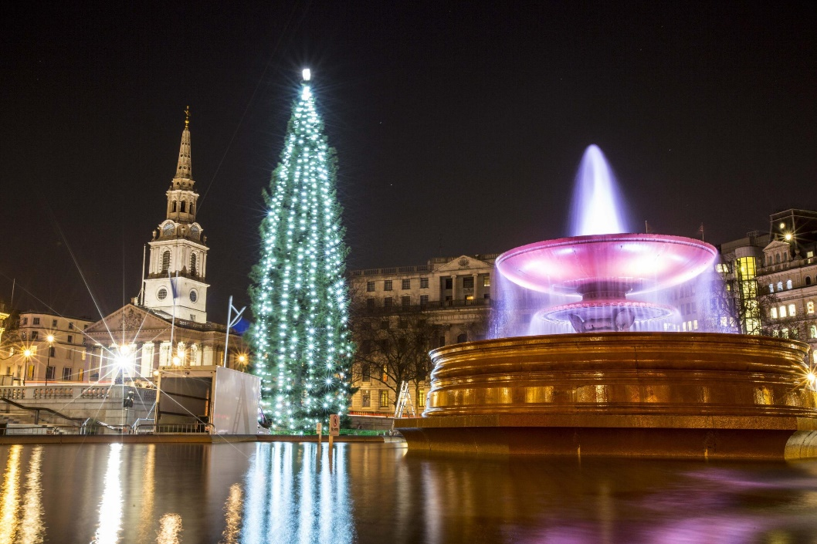
When do British people celebrate
Christmas?
25th of December.

Slide 27
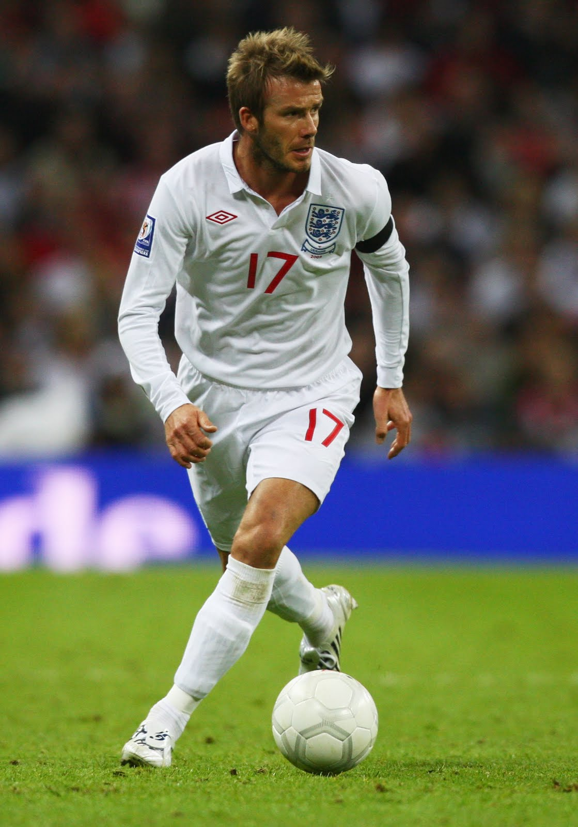
What’s the most popular sport
in Britain?
football

Slide 28
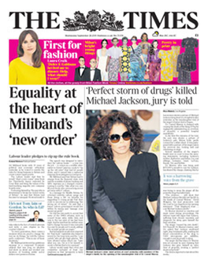
What is the most popular British newspaper?
the Times

Slide 29
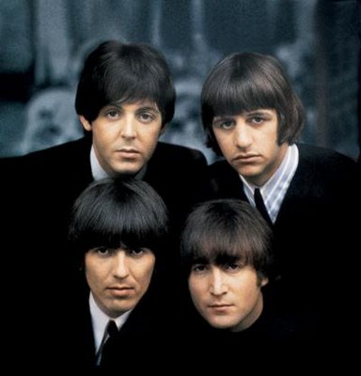
Name this British group
The Beatles

Slide 31
Well done !!!

